Slide 1
Row_Number( )

Slide 2
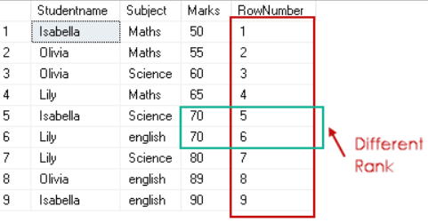
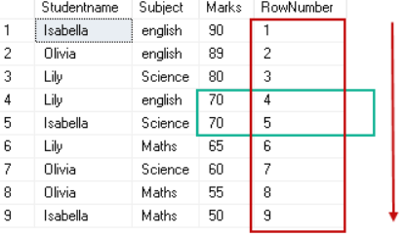
1_ROW_NUMBER()-basic_Window-Function_SQL.ipynb

Slide 3
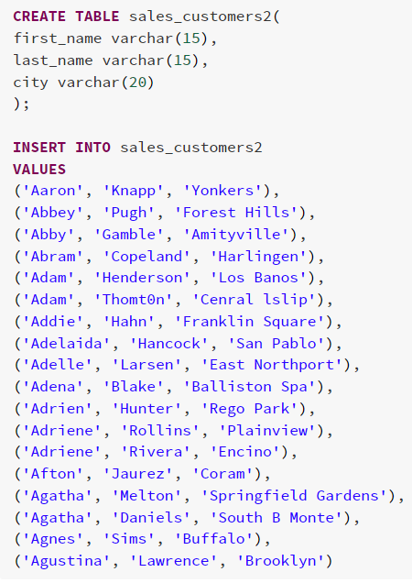
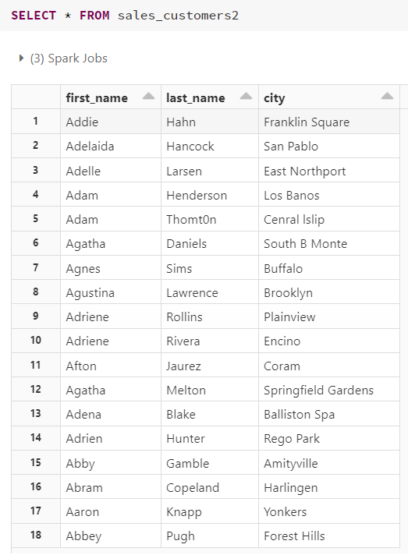
2_ROW_NUMBER()_Window-Function_SQL.ipynb

Slide 4
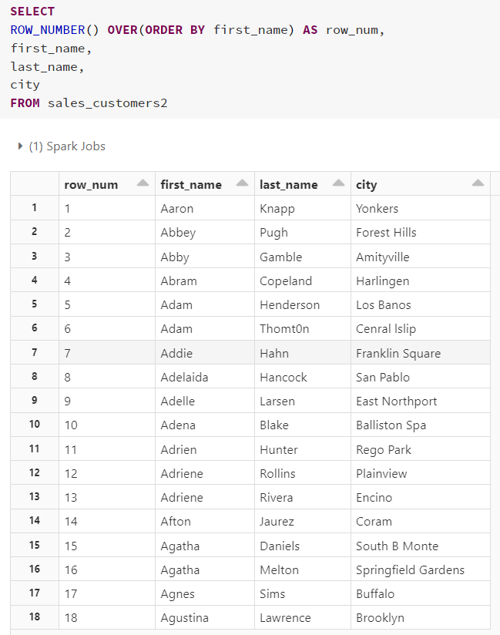

Slide 5
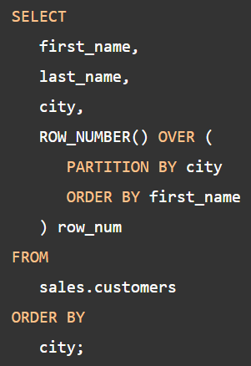
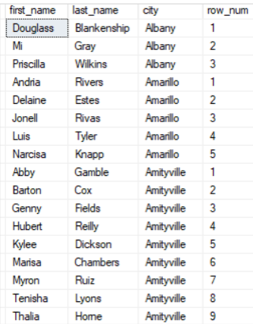
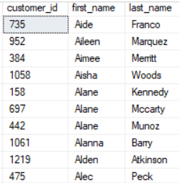
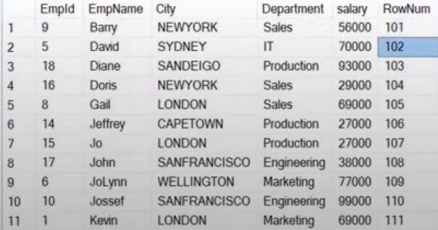
Partition By; Order By
Pagination (CTE)
ROW_NUMBER() OVER(ORDER BY EMPNAME) + 100 AS ROWNUM

Slide 6
Rank( )

Slide 7
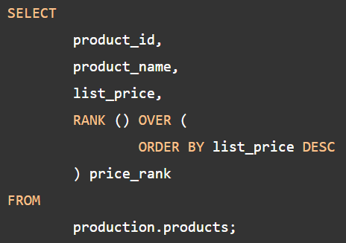
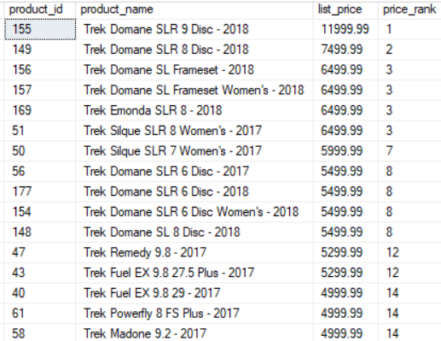

Slide 8
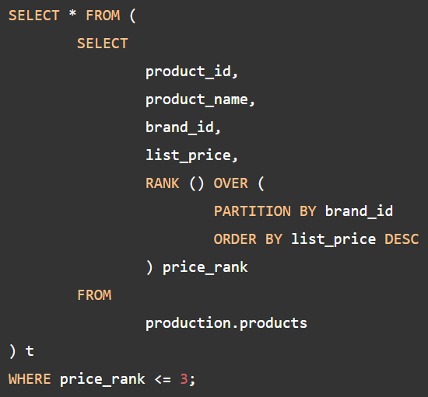
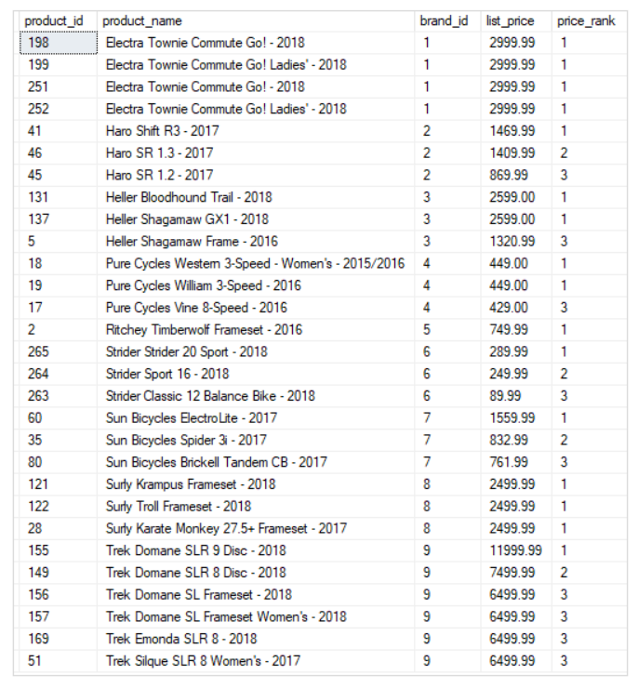

Slide 10
Dense_Rank()

Slide 12
NTILE()

Slide 13
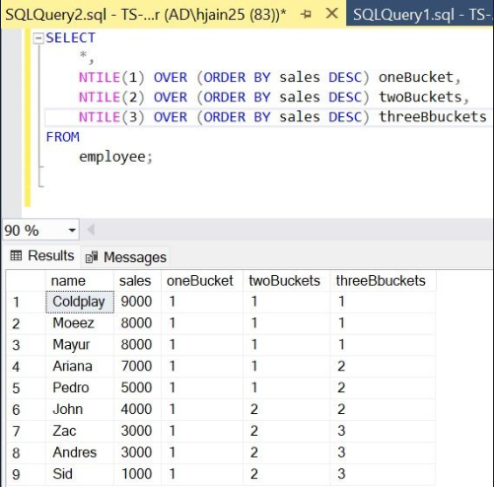

Slide 14




